Slide 1
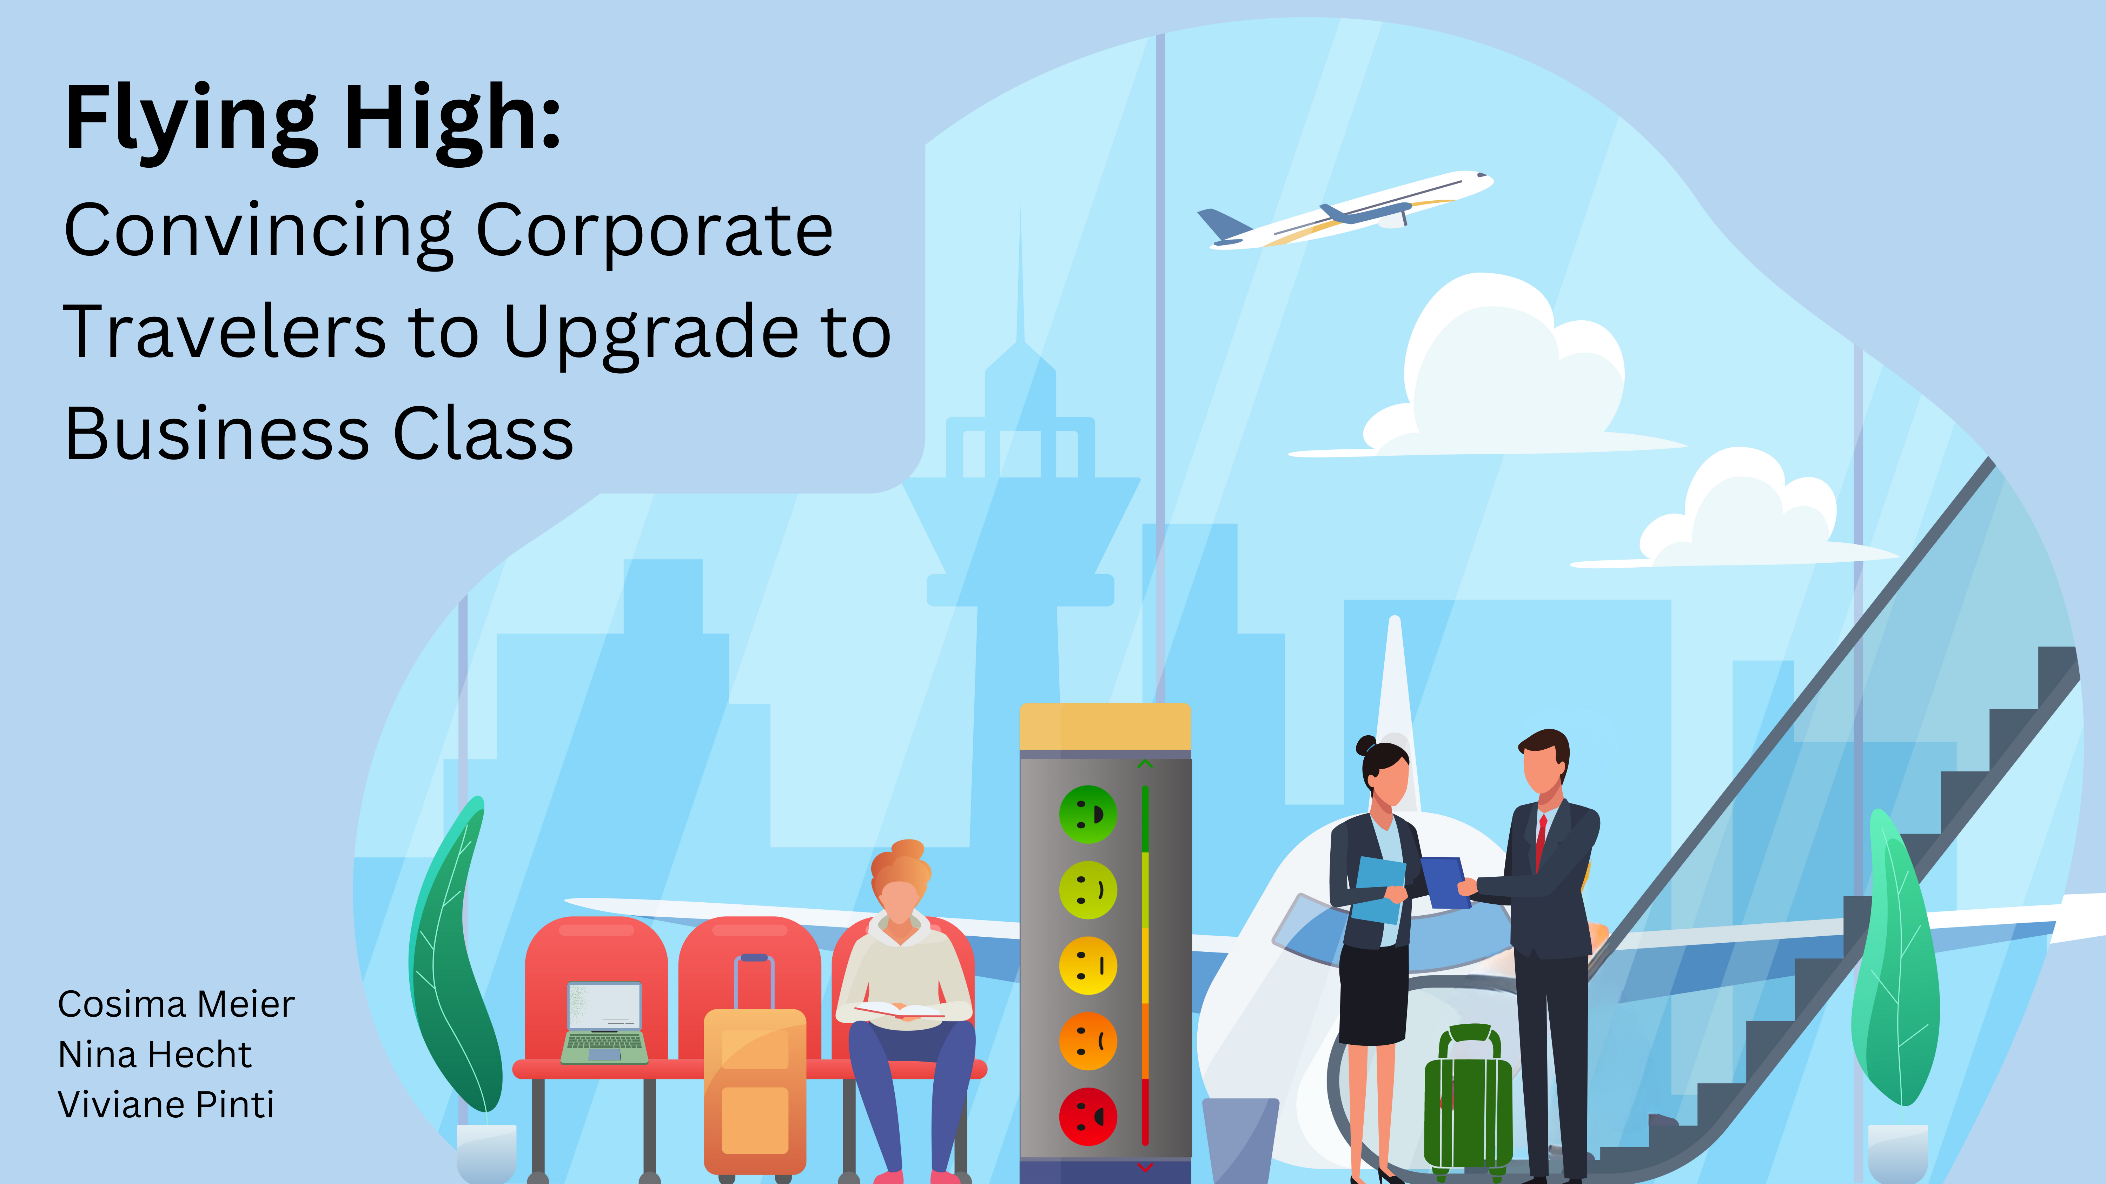
Notes:
Hi ,everyone! We are excited to share and discuss with you our data analytics project. The title of your project is: Flying High: Convincing corporate travelers to upgrade to business class. This titel already alludes to our objective. However, before delving into further details, let me first explain the rationale behind our approach.

Slide 2
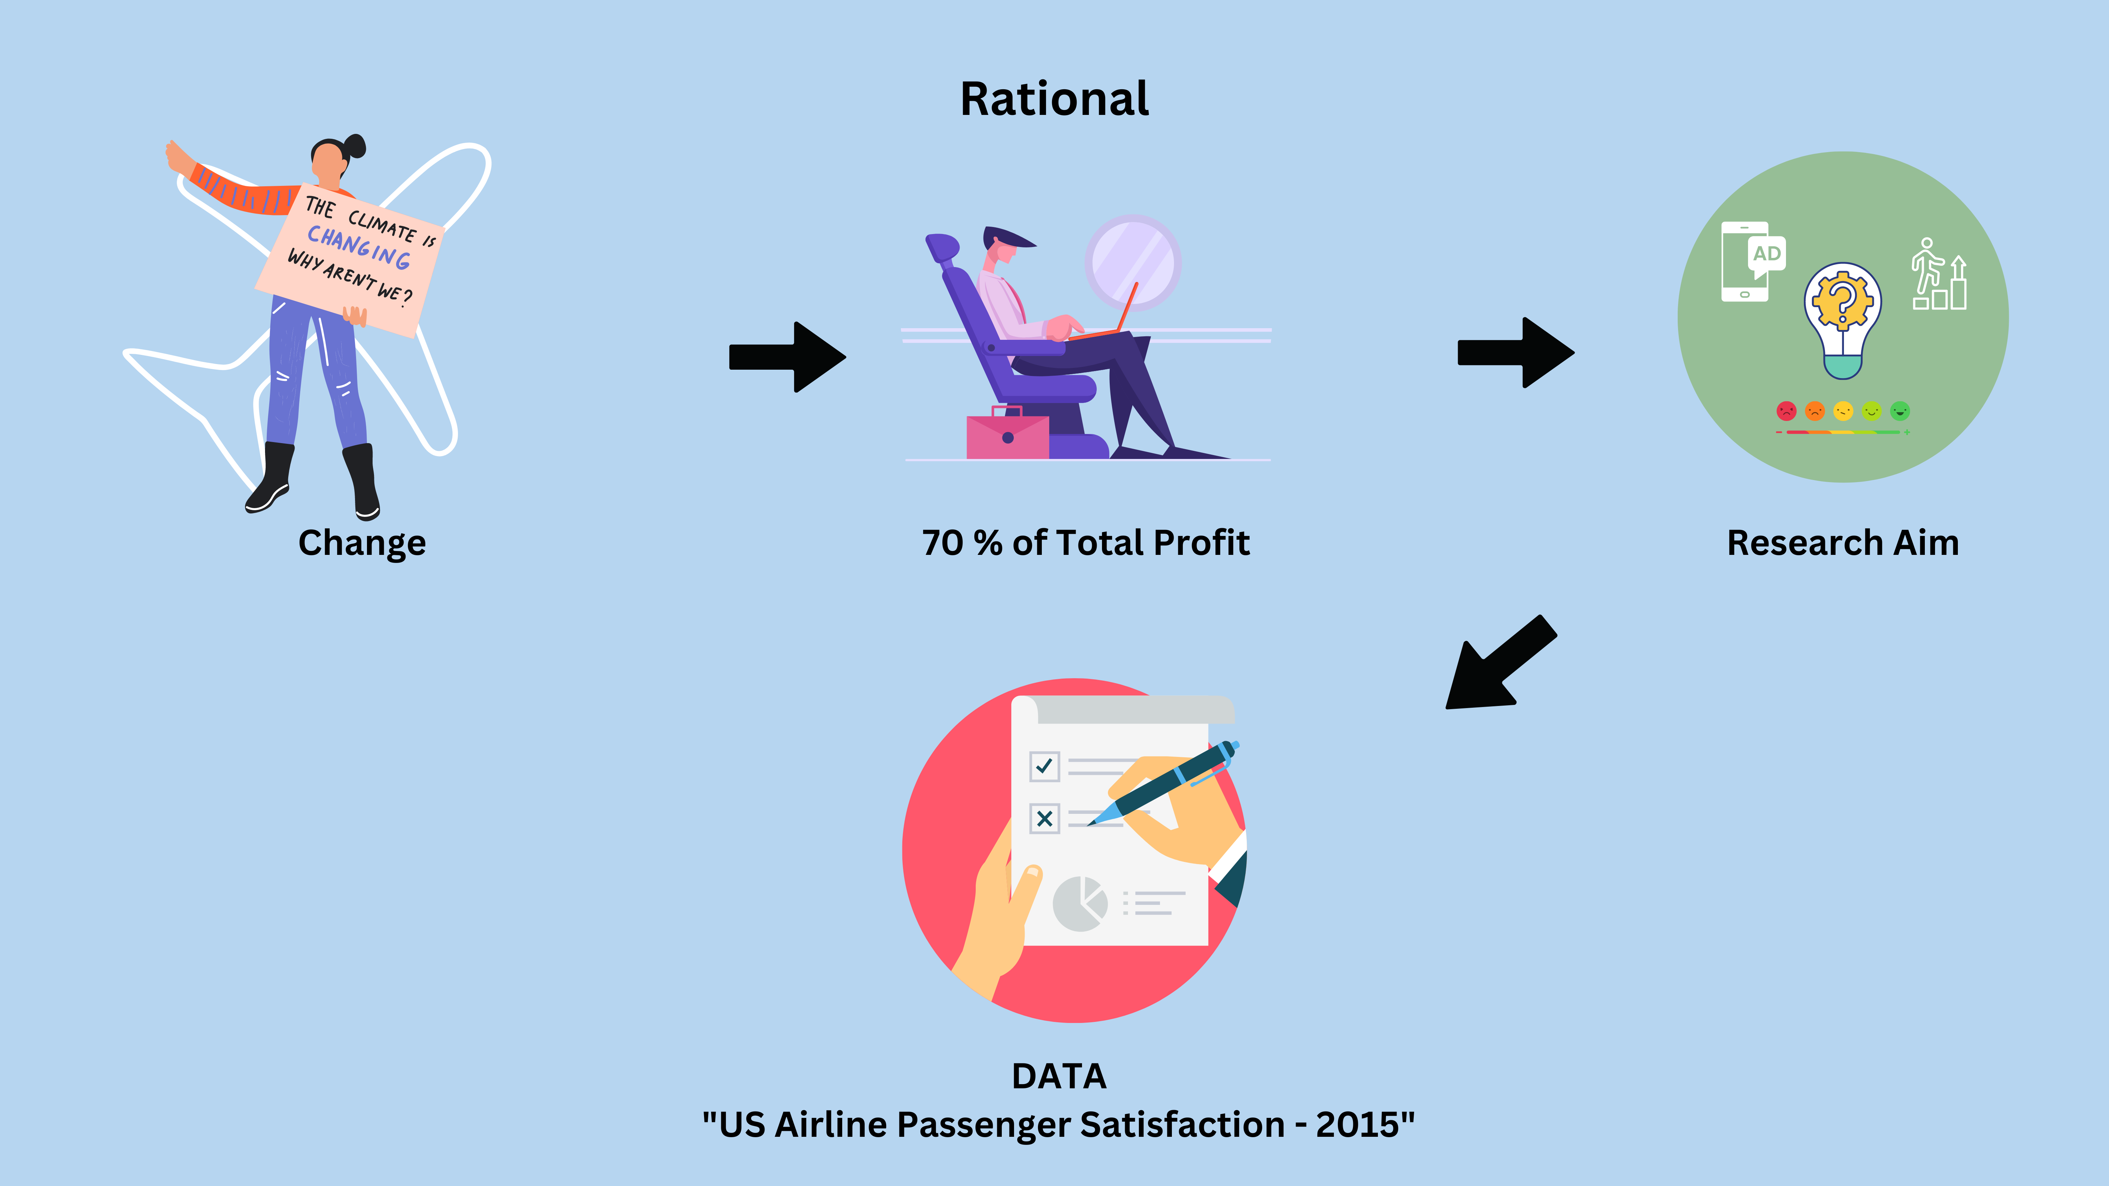
Notes:
Climate change and the respective mitigation actions taken also affect the aviation industry by potentially reducing the amount of air travel. This is because people may become more aware of the CO2 impact of flying on the planet and global warming. This will lead to fewer customers and therefore increased competition between airlines. It is therefore important for airlines to gain a competitive edge, for example by ensuring that their customers' needs are met.
A very important customer segment to be aware of is corporate travelers. Not only will they continue to travel for specific business reasons, but they also generate up to 70% of total profits by flying business or first class. It is therefore important to understand the needs of these valuable customers. Interestingly, not all corporate travelers fly business class, some also fly economy. Since business class is tailored to the needs of business travelers, a lot of profit and perhaps even satisfaction is lost. And this leads as straight to our research aim
Our aim is to identify which services should be marketed to corporate travelers flying economy class to convince them to upgrade to business class. By doing so, we can enhance passenger satisfaction for the airline, providing them with a competitve advantage and driving profitabillity for this airline.
We do not, however, aim to improve the services.
To answer this research question, we worked with the US Airline passenger Satisfaction Data set from 2015. This dataset includes ratings of 14 air travel services (on a 5-point likert scale ) as well as additional information about each passenger, such as their class and type of travel. In total about 130’000 individuals particpated in these surveys.

Slide 3
1) Data Wrangling:
Created subset only with necessary variables
NA’s analysis: For each satisfaction variable: between mind. 0% ; max: 5.14% (mean: 0.8%)
Final plot only works with data from corporate travelers
2) Generate first Insight:
Investigated the different mean satisfaction between corporate and personal travellers between Business and Eco class:
Corporate travelers were less satisfied in economoy class than personal travelers
Corporate travelers were more satisfied in business class than personal travelers
-→ Needs of corporate travelers are not fully met in economoy class & they would be more satifisied upgrading to business class
Tried a few plots to answer our research question: (following slides)
Reflection
- Nicht immer inferenzstatistik betreiben (haben wir direkt gemacht)

Slide 4
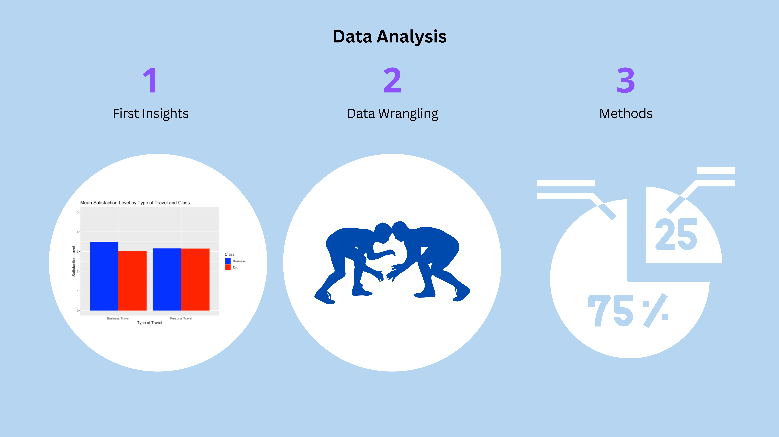
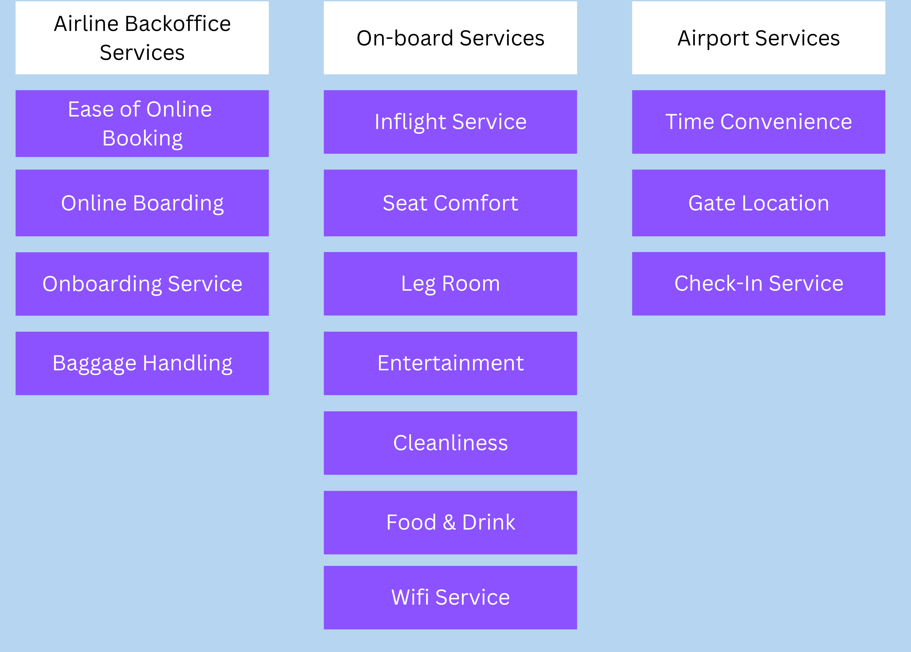

Slide 5
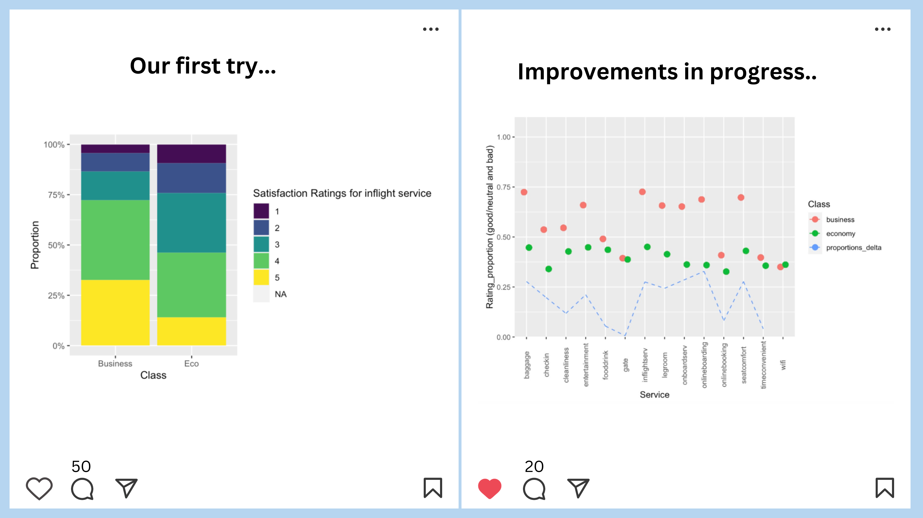

Slide 6
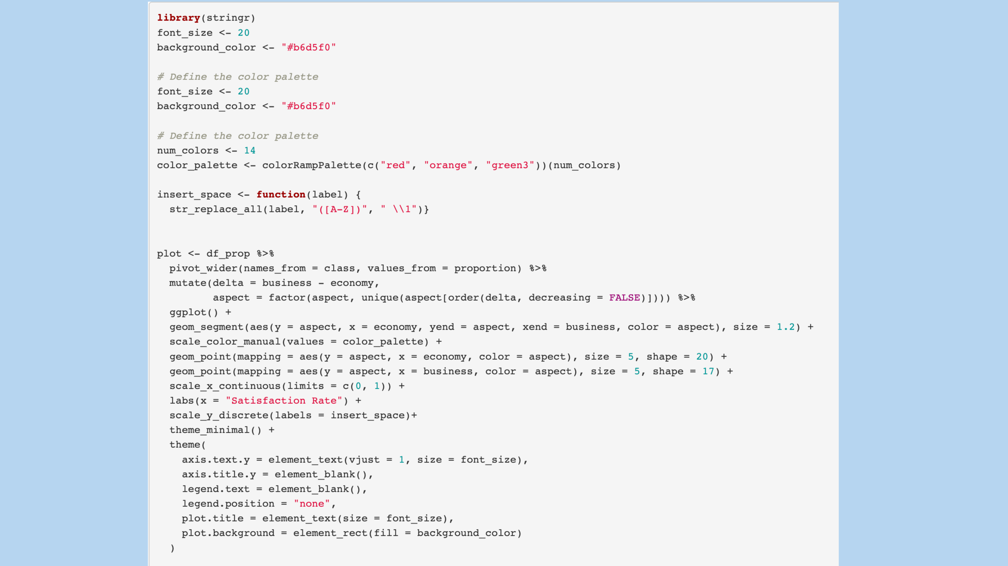
Notes:
Next, we would like to take a closer look at our final plot.
Here you can see the code for our final plot. Let's go through it step by step. We will only go into the most interesting parts.
First, we defined the color palette for our plot. And it is a color gradient from green to red.
The next section of code we used to get the labels all in the same style at once. We first had labels that were written end to end and wanted to separate them, so we added a space and continued with a capital letter.
Now the code for the actual plot begins. First of all, we have mutated the order of the labels according to the delta. That is, the largest delta should be at the top and become smaller towards the bottom.
At the next arrow you can see the code for the visualization of our plot. The special thing about it is that we used "geom_segment" for it. In our plot, we wanted to show the satisfaction ratings of the economy class on the one hand, but also those of the business class and connect these two points with each other. That's why we used geom_segment.
First, we have defined the x and y normally here. On the y-axis we have Aspect. This variable stands for the different services. On the x-axis is economy, which is the class. Next in the code is "yend", which is the second point on the Y-axis. Again, we want the point at the corresponding service, therefore aspect. And xend is the business.
Now we would like to show you our final plot.

Slide 7
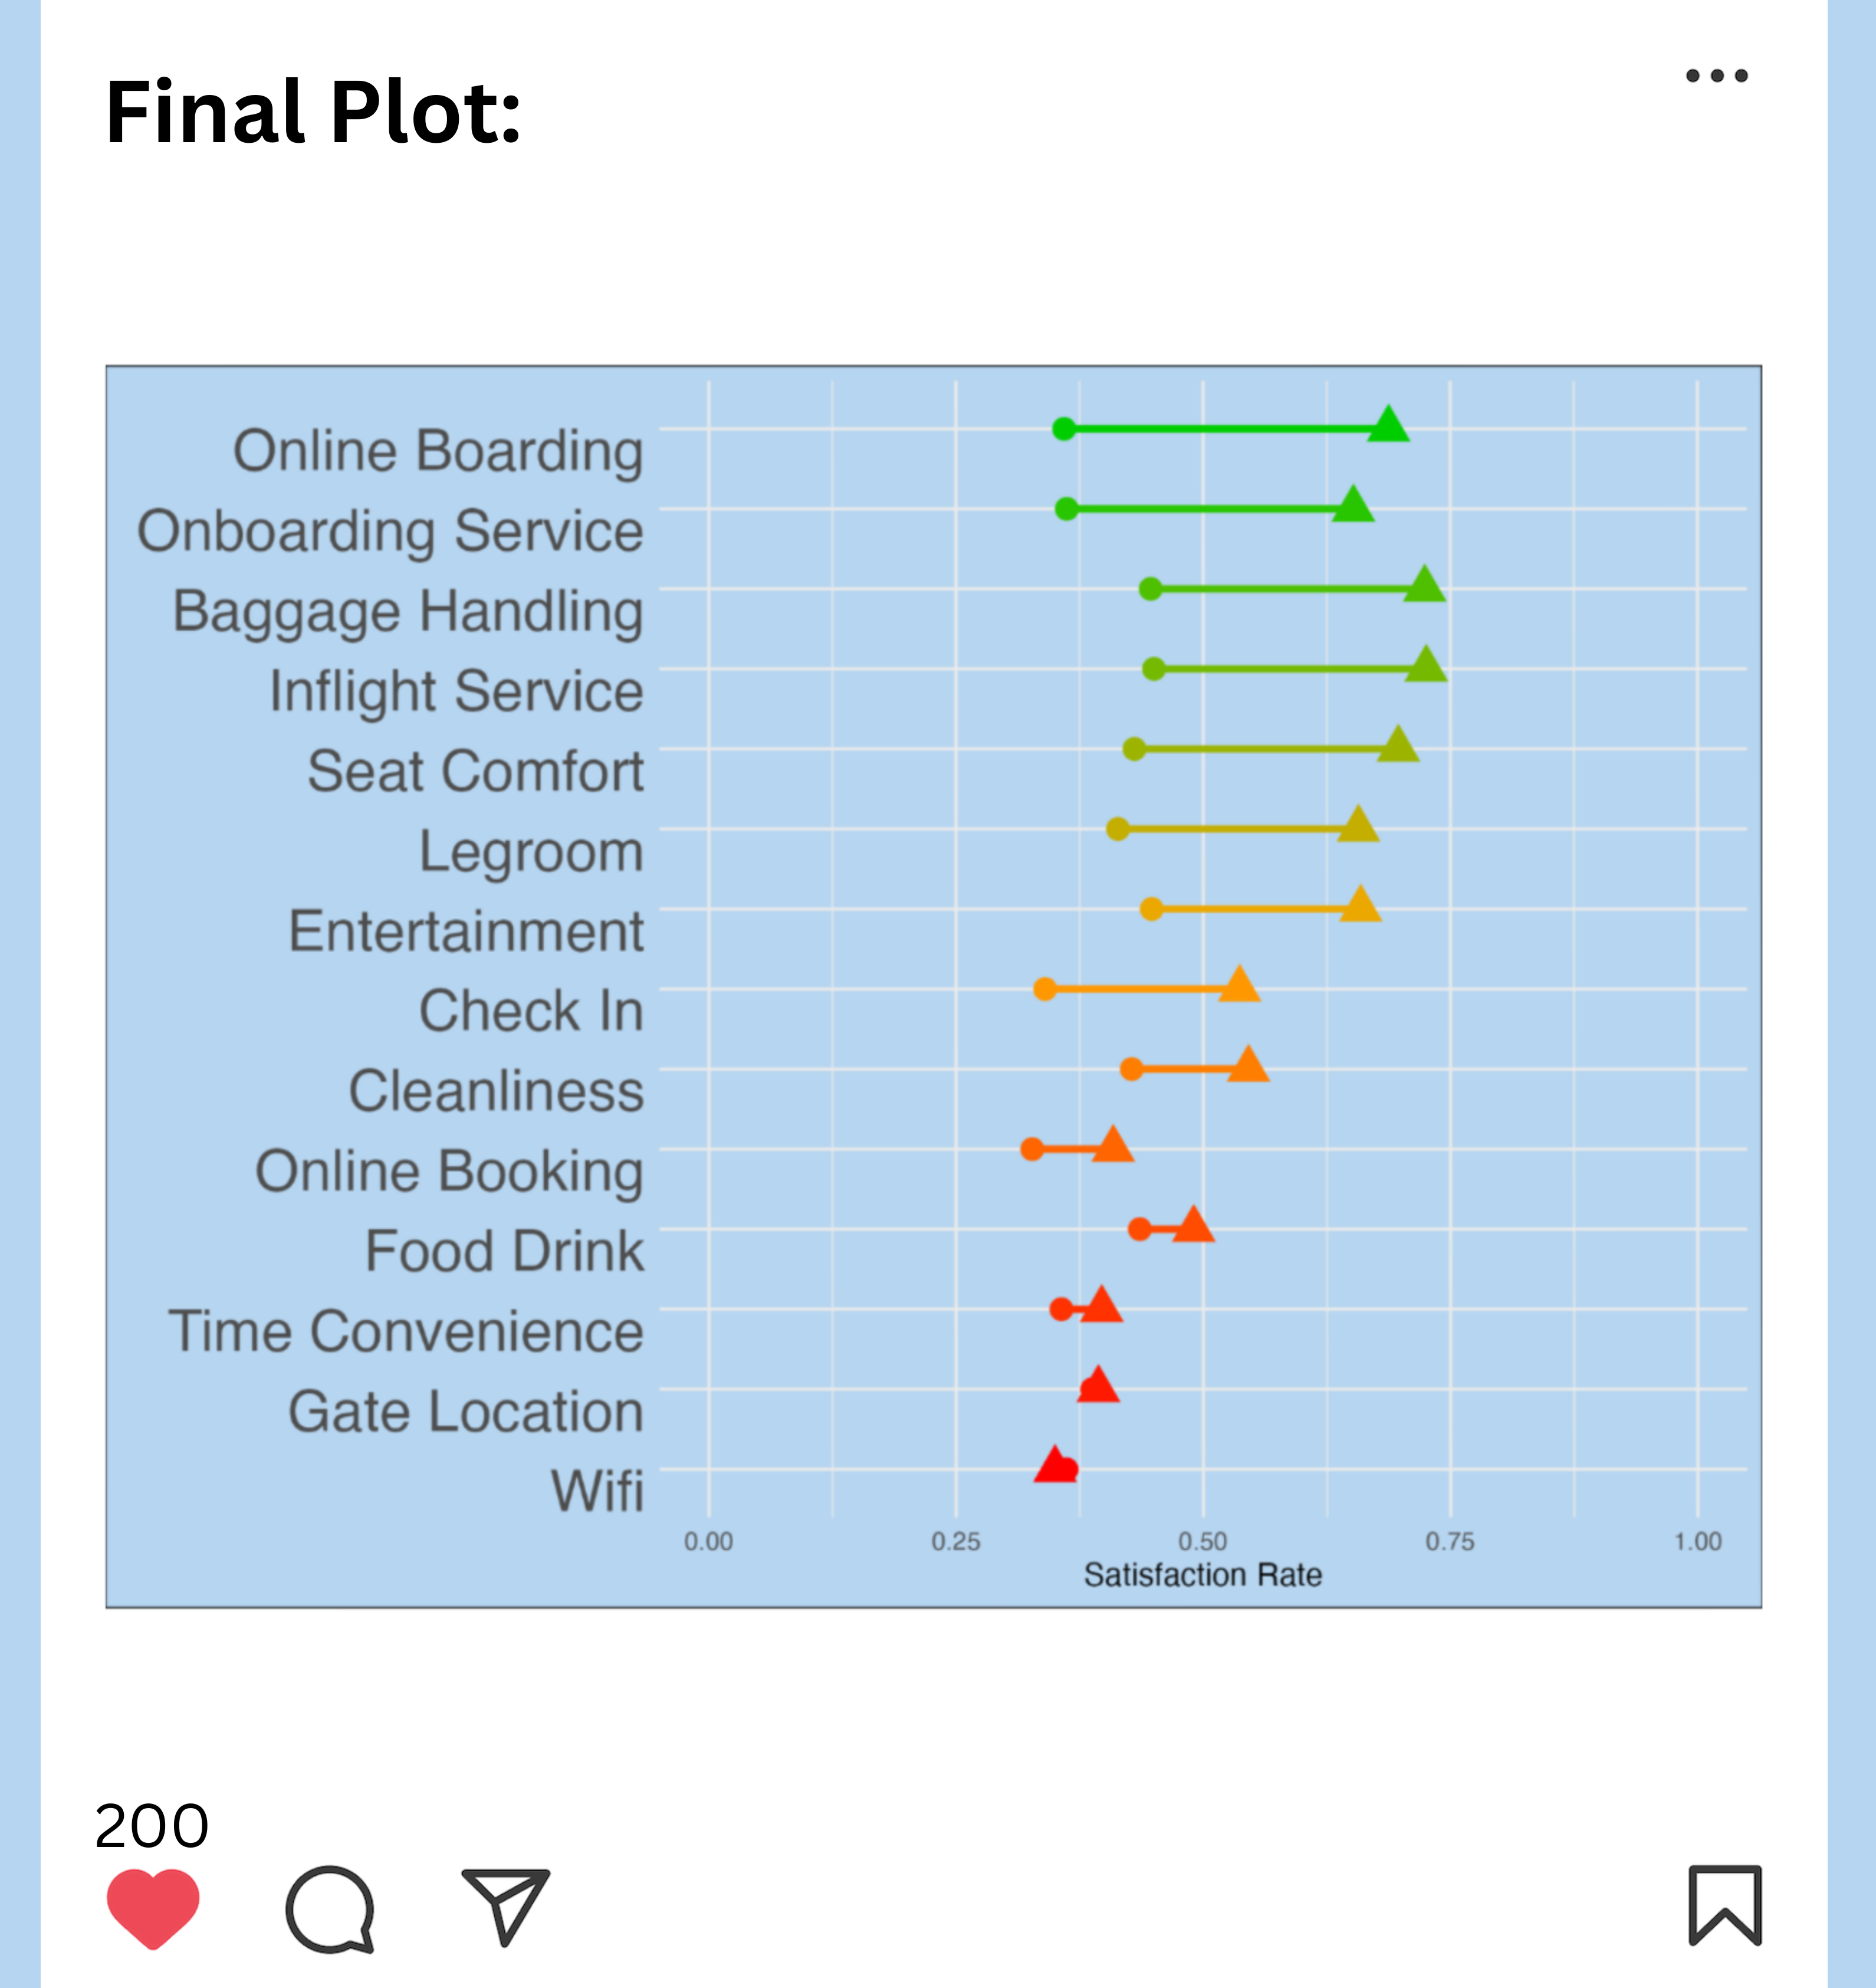
Notes:
Let's take a closer look at the first service: Online boarding.
About 30% of corporate passengers in economy are satisfied or very satisfied with online boarding. Shown with a dot in the graph. In business class, on the other hand, almost 75% of corporate travelers are satisfied or very satisfied with online boarding. There is therefore a big difference between economy and business class. Consequently, corporate travelers in economy class could be persuaded with marketing activities to upgrade to business class, as their needs in terms of online boarding are much better addressed here

Slide 8
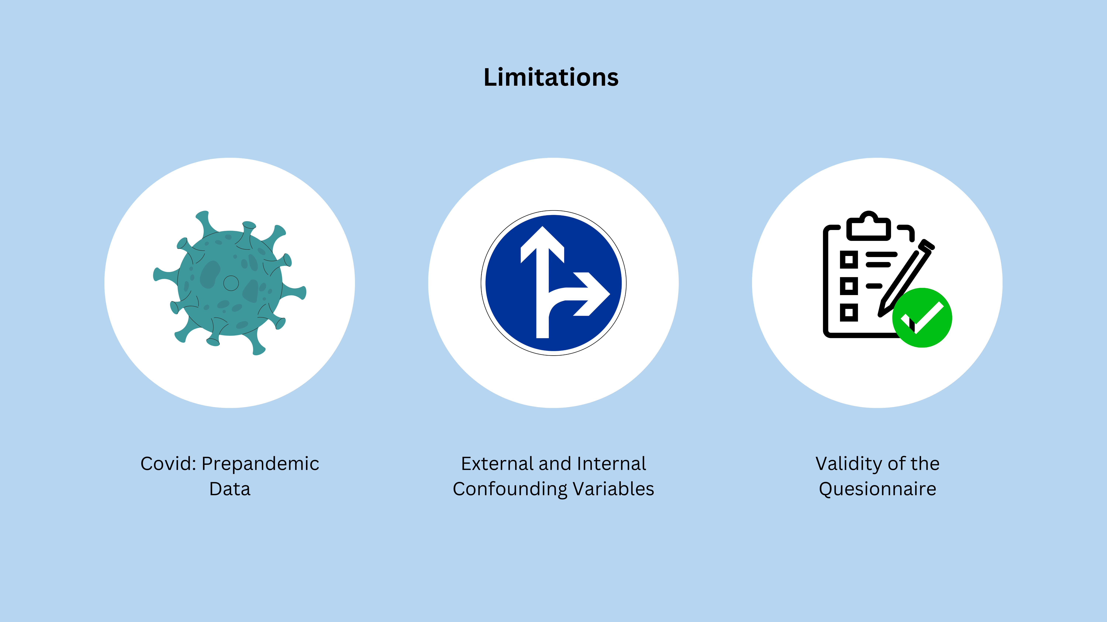
Notes:
In the beginning, it was difficult to integrate the issue of climate change and the problem the aviation industry Is creating for the earth. A limitation of our results are that the data set is from 2015 so those are precovid data and the airtravel might have changed quit a bit.
Moreoever, we haven’t considered all external and internal confounding variables (such as external: socioeconomic status, purchasing power; and internal: flight distance, what the different services entail)
And finally, the Validity of the questionnaire cannot be assessed
Overall during the project, we had a great time and fun working together as a team and learned a lot, making the seminar a truly enjoyable and educational experience.

